Slide 1
WELCOME
Class: B.Com – Part-1
Subject: Financial Accounting
Topic: Installment Payment System– Part - B
Prepared By
Dr. SHAHID IQBAL
Guest Faculty
Marwari College, Darbhanga,
Mobile no. and Whatsup no. : 7004160257
Email ID: shahidlnmu@gmail.Com

Slide 2
Accounting Record Under Installment System:
Interest Suspense method is applicable in case of Installment Payment System. Under this method, asset account is debited with the full amount of Cash Price and Interest Suspense Account is opened which is debited at the time of taking delivery by the total amount of interest paid for all the years and the same is credited by debiting Interest Account in each subsequent year.
In the next slides, the necessary journal entries are given which need to be passed in the book of purchaser and vendor.

Slide 3
Journal entries in the books of purchaser:
1. For purchasing goods under installment system:
Assets A/C(total cash value)..............Dr.
Interest suspense A/C(total interest).........Dr.
To vendor A/C
2. For payment of cash down value
Vendor A/C..................Dr.
To Bank A/C
3. For interest due
Interest A/C..............Dr.
To Interest suspense A/C

Slide 4
4. For payment of installment
Vendor A/c.............Dr.
To bank A/C
5. For depreciation charges
Depreciation A/C.............Dr.
To Asset A/C
6. For transferring interest and depreciation
Profit and loss A/C ..................Dr.
To interest A/C
To depreciation A/C

Slide 5
Journal Entries In The Books Of Vendor
1. For selling goods on installment system
Buyer A/C..................Dr.
To sales A/C(total cash value)
To interest suspense A/C
2. For receiving cash down value
Bank A/C....................Dr.
To Buyer A/C
3. For interest due
Interest suspense A/C...........Dr.
To interest A/C

Slide 6
4. For receiving installment
Bank A/C...................Dr.
To Buyer A/C
5. For transferring interest
Interest A/C............Dr.
To profit and loss A/C
6. For transferring sales to trading account
Sales A/C ...............Dr.
To Trading A/C

Slide 7
Illustration:
A purchased, on installment basis, a machine from B on 1st January, 2003, for a sum of Rs 80,000. Rs 20,000 is to be paid on signing of the contract and rest in three installments of Rs 20,000 each. The cash price of the machine is Rs 74,500 and interest is charged by the vendor at 5% p.a. The buyer charges depreciation at 10% p.a. on the diminishing balance.
You are required to pass necessary journal entries in the books of both the buyer and the vendor.

Slide 8
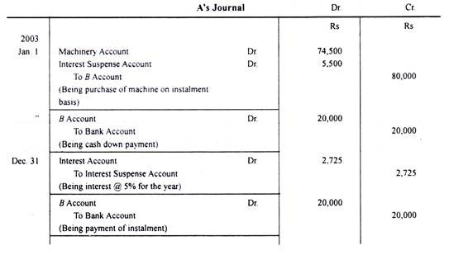

Slide 9
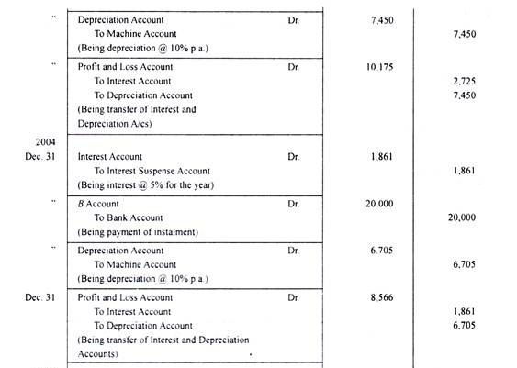

Slide 10
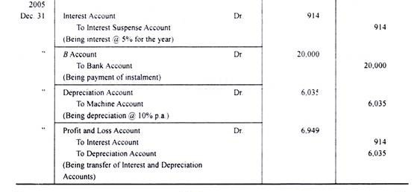

Slide 11
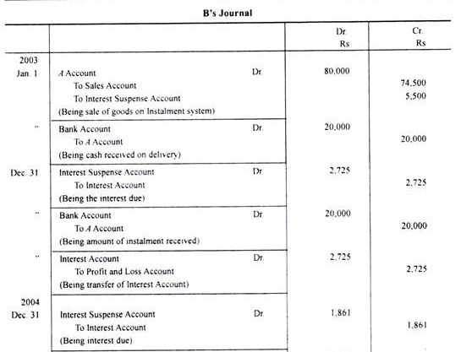

Slide 12
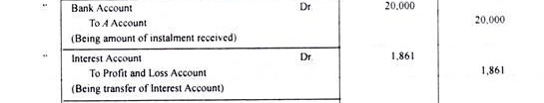
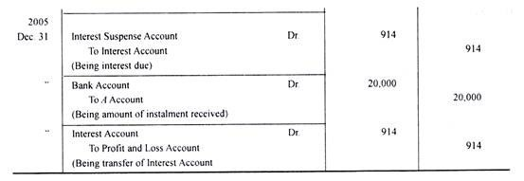

Slide 13
Thank You

